Slide 1
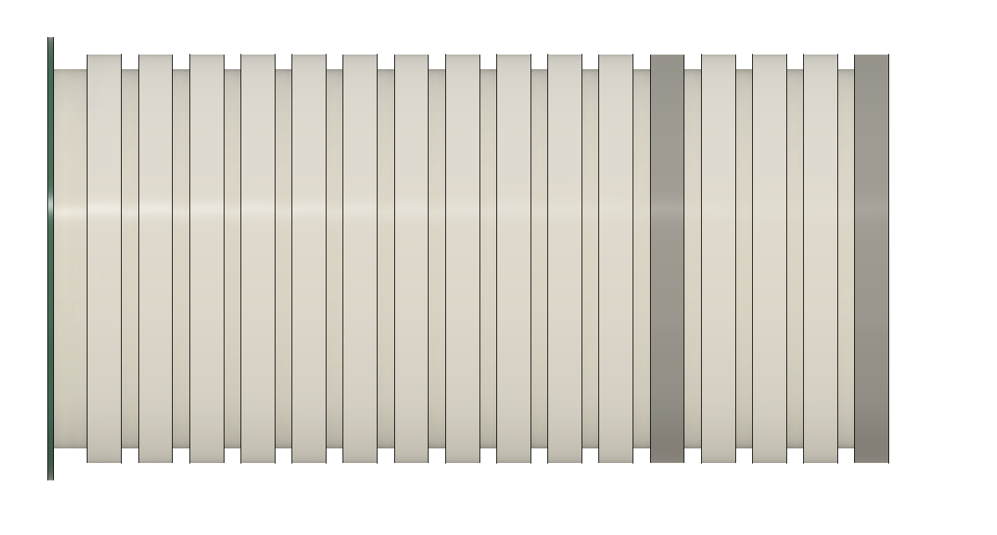
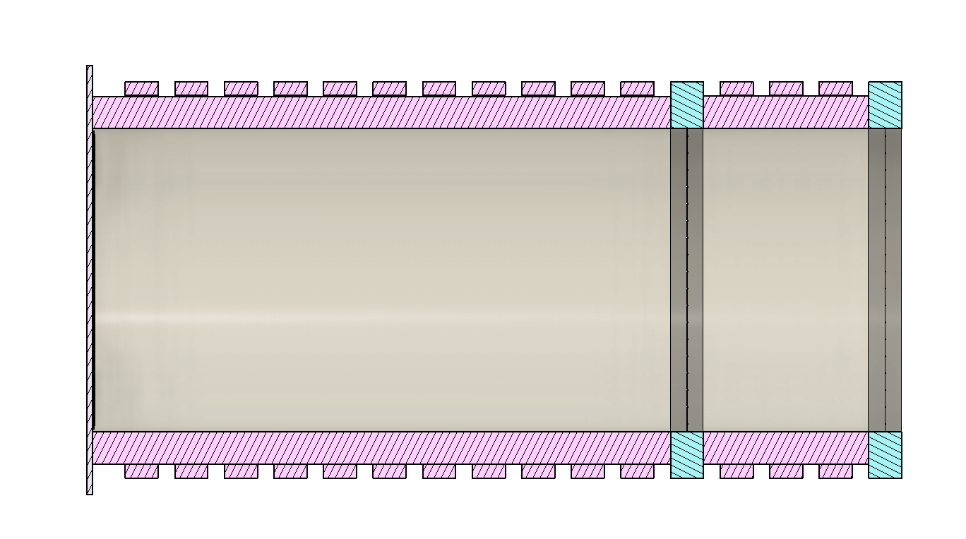
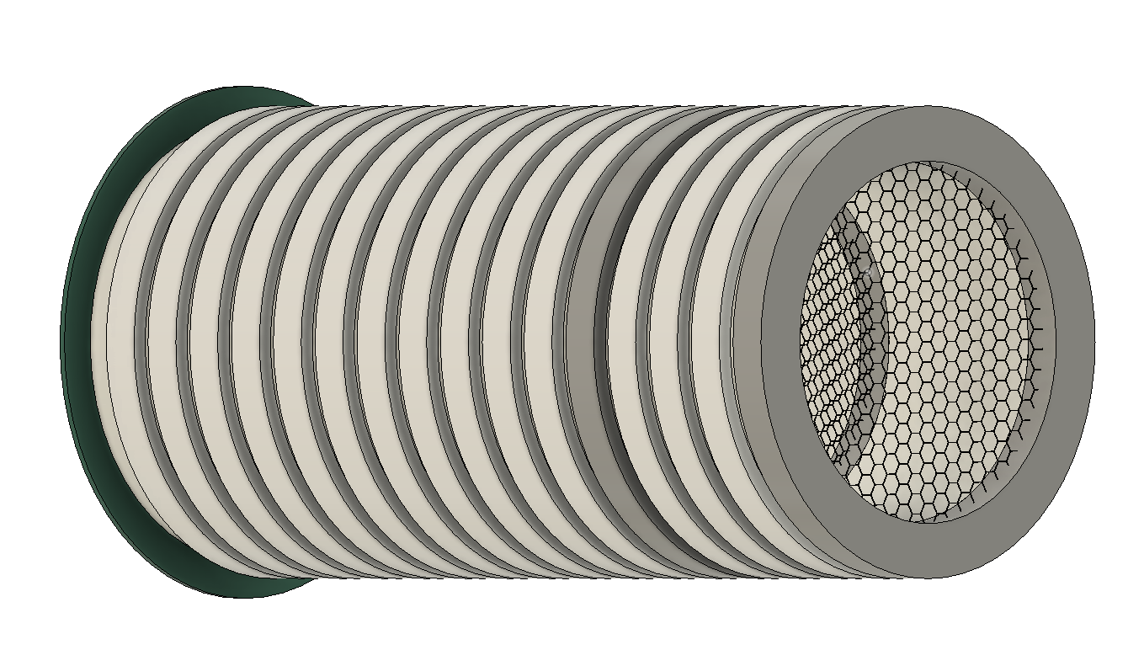
Side View
Cross Section Cut
Side Tilt View
A
B
C
D
E
F
A – Collection Plane B – Electron Field Rings C – Electron Drift Region D – High Density Polyethylene
E – Hexagon Mesh Grid Field Rings F – Buffer Region

Slide 2
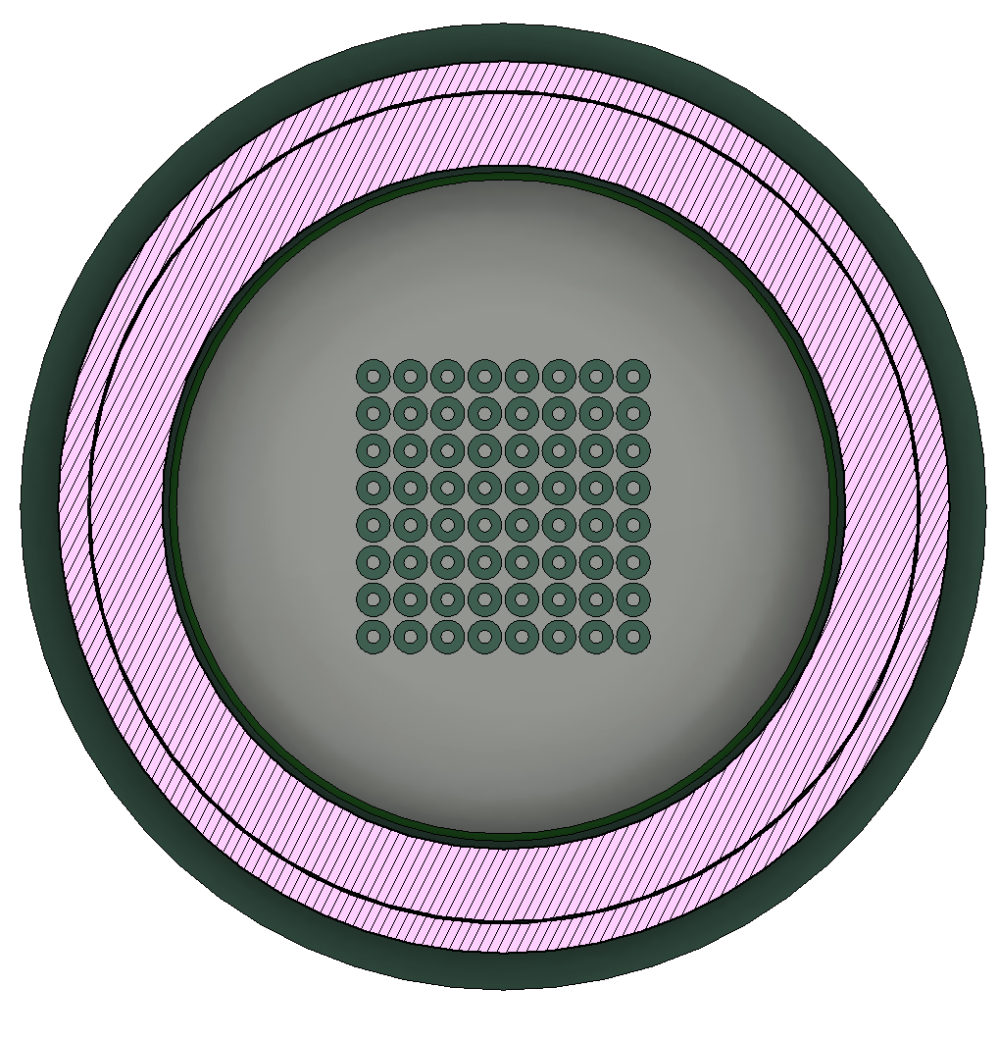
Pixel
Mesh Grid
HDPE
Field Cage Ring

Slide 3
TPC Regions of Interest for Simulation
Charge Drift Region
Buffer Region

Slide 4
TPC Field Configurations
Positive Voltage Bias
Negative Voltage Bias
V = 0
HV +
V = 0
V = 0
HV -
V = 0
Legend
Force on Positive Charges
Force on Negative Charges
Enlarged Arrows to express area of effect

Slide 5
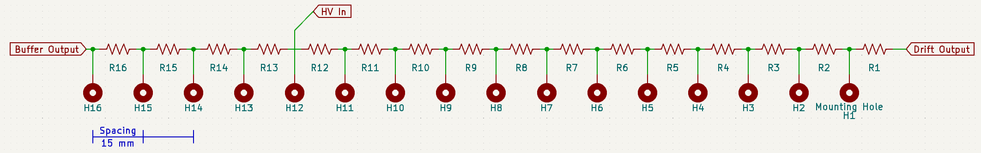
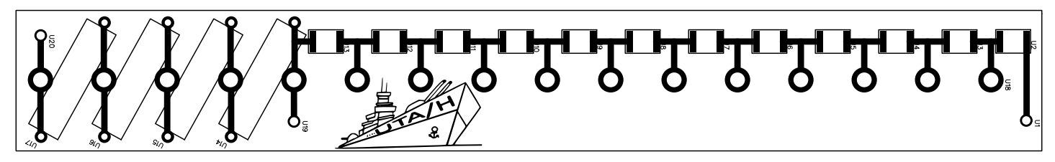
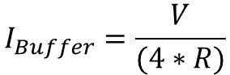
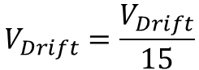
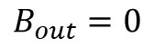
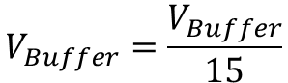
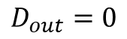
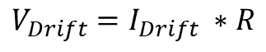
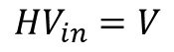
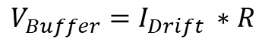
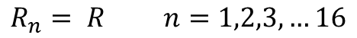
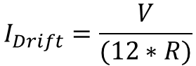
Cage Potential Circuit Diagram
2D Render of PCB Board
From Original Documentation
Static Field Cage Calculations
Boundaries
Currents
Voltage Drop per Resistor
Voltage Drop / mm
$R_{n}= R$ $n=1,2,3,…16$
$$I_{Buffer}=\frac{V}{(4∗R)}$$
$V_{Buffer}=I_{Drift} ∗R$
$$V_{Buffer}=\frac{V_{Buffer}}{15}$$
$${HV}_{in}=V$$
$$D_{out}=0$$
$$I_{Drift}=\frac{V}{(12∗R)}$$
$$V_{Drift}=\frac{V_{Drift}}{15}$$
$V_{Drift}=I_{Drift} ∗R$
$$B_{out}=0$$

Slide 6
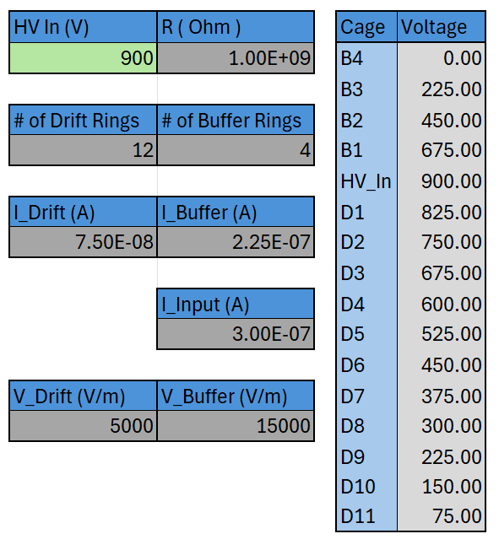
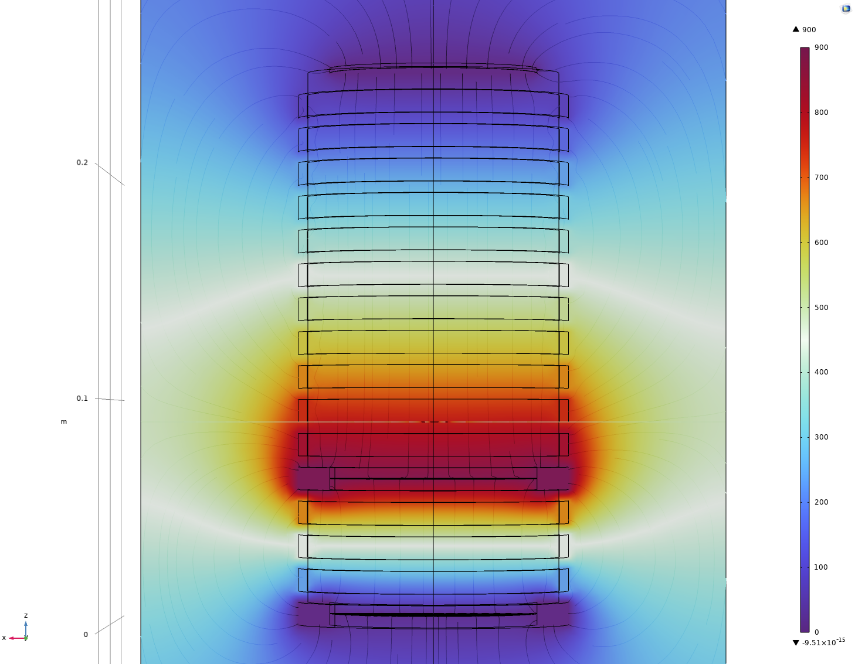
Excel Sheet Calculator
COMSOL Simulation
Expected Drift Directions from Simulation Results
B4
Voltage In
Resistor Value
B3
Number of Static Rings per Area
B2
B1
Field Section Currents
HV
System Current
D1
D2
Field Voltage Drop
D3
Ring Bias
D4
D5
Changing the green box in the excel sheet will update all values. All other values are constant or set.
D6
D7
D8
D9
D10
D11
Enlarged Arrows to express area of effect

Slide 7
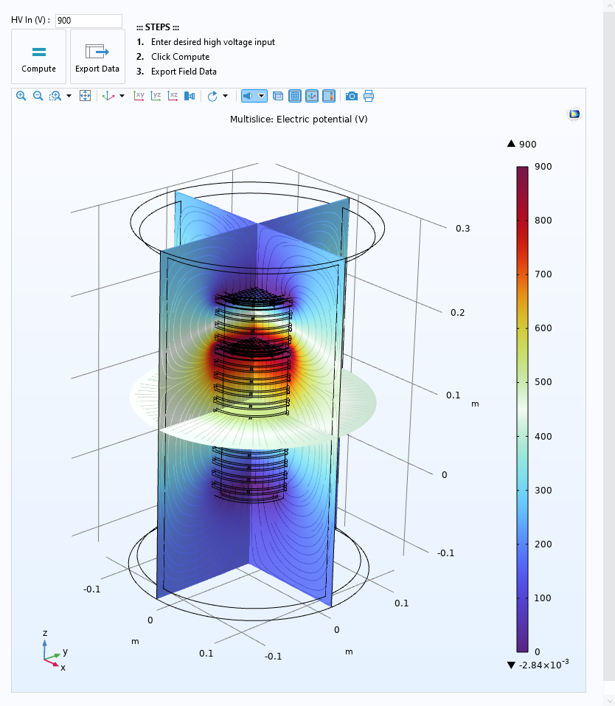
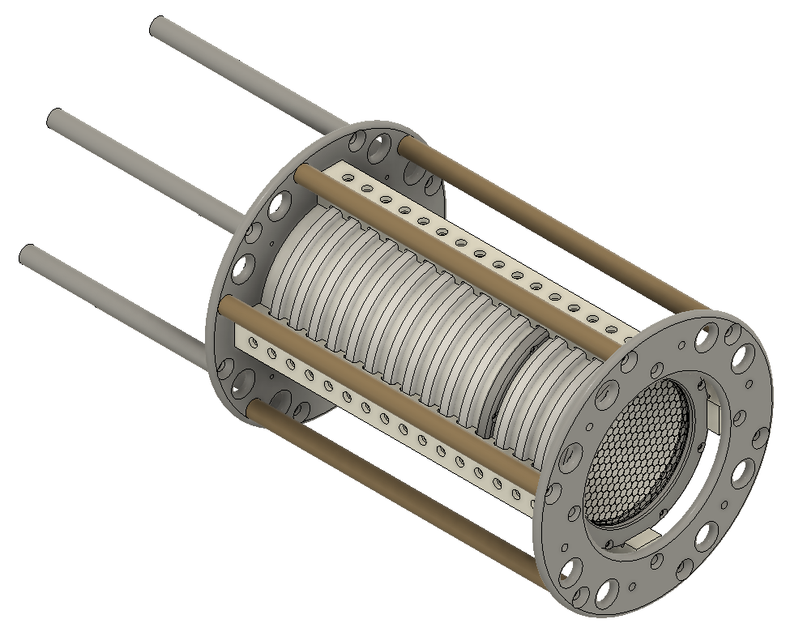
COMSOL Application for Field Cage Analysis of Real Model
The solutions to the UTAH TPC Electric Field have been set up in COMSOL. High Voltage can be adjusted for desired input voltage, then it can be solved using the [COMPUTE] button Field Values can be exported as a .txt document using the [EXPORT DATA] button ElectricField.UTAHTPC.mph can be used for initial analysis for field values. Model contains only the “central” system and none of the mechanical supports.

Slide 8
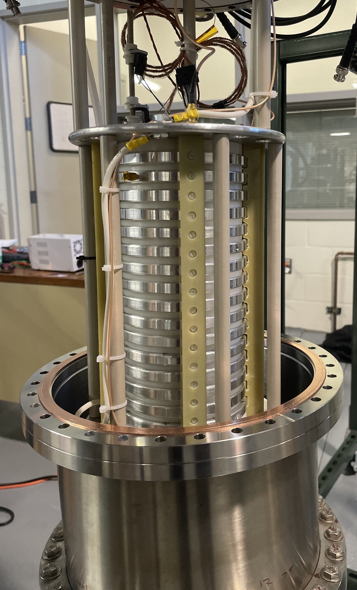
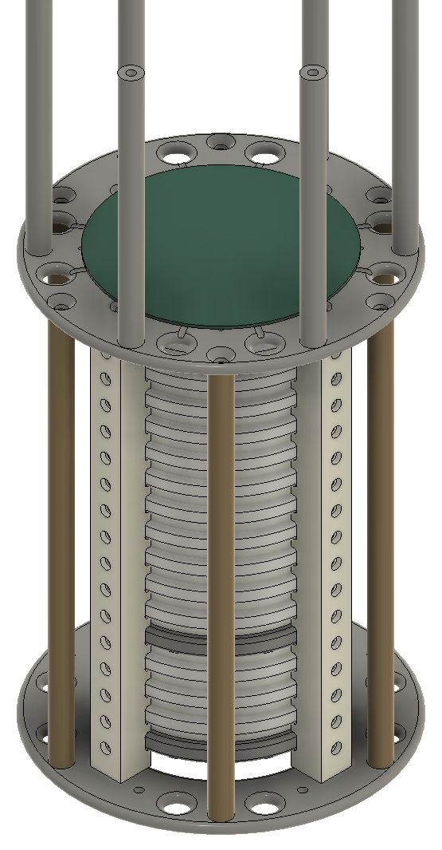
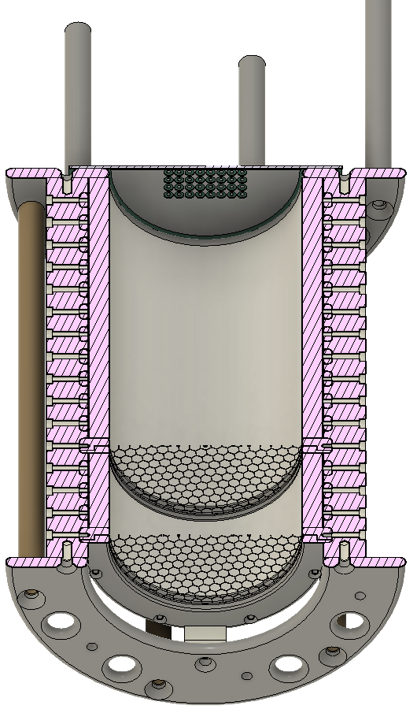
Reality
Complex Model
Complex Simulation Model
More Information of the System available in the original documentation

Slide 9
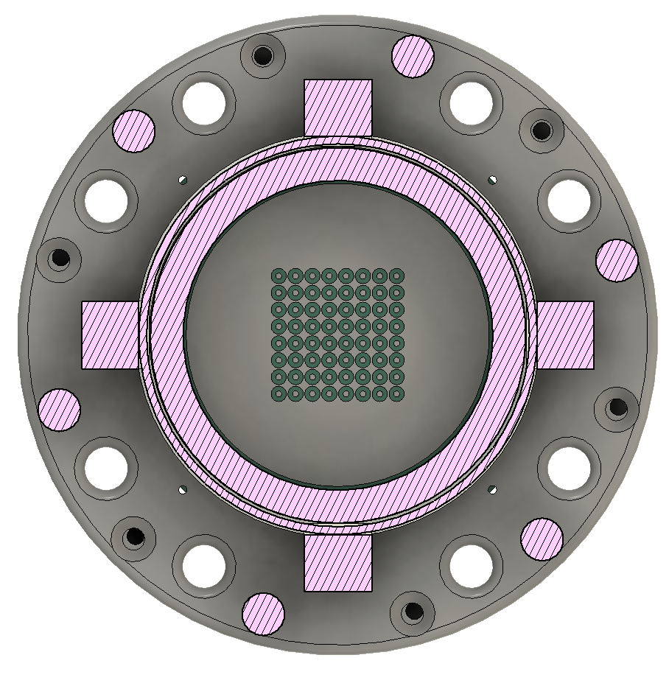
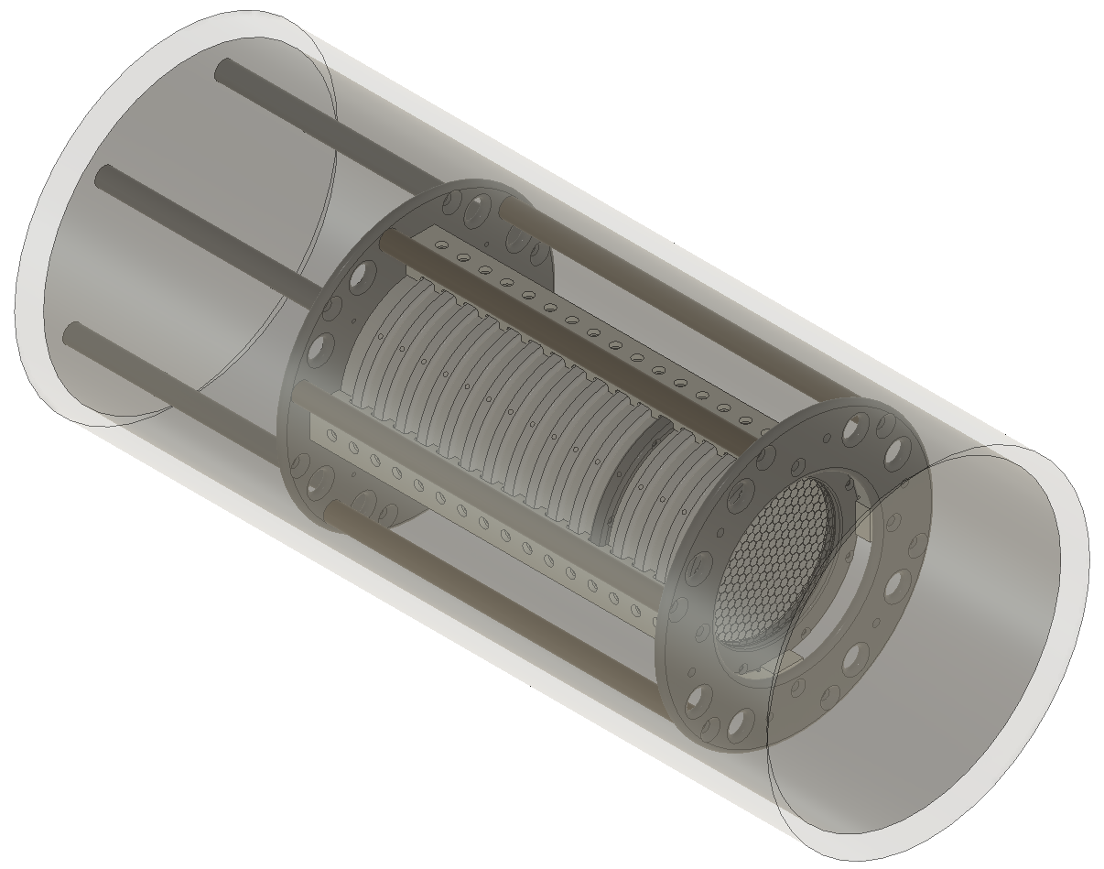
Complex Simulation Model
Pixel Plane and Mesh
Models Available
Exposed TPC
Enclosed TPC
Similarly to the simple geometry model… Field Cage Rings, Mesh Grid, Pixels Pads and HDPE are present. Additional components like the G10 Legs, and PEEK Supports and Plates have been added for a closer representation of the built model. More information on the system is available in the documentation of the original files.

